Slide 1
Module 7.6 Real World Protocols

Slide 2
Real-World Protocols
Secure Sockets Layer (SSL)
Client/server authentication, secure data exchange
Secure Multipurpose Internet Mail Extensions Protocol (S/MIME), PGP
Secure Electronic Transactions (SET)
Internet Protocol Secure Standard (IPSec)
Authentication for networked devices

Slide 3
Basics Steps
Authenticate (validate the other side)
Key agreement/exchange (agree on or exchange a secret key)
Confidentiality (exchange encrypted messages)
Integrity (proof message not modified)
Nonrepudiation (proof you got exactly what you want)

Slide 4
Secure Sockets Layer (SSL)
Developed by Netscape
Provides privacy
Encrypted connection
Confidentiality and tamper-detection
Provides authentication
Authenticate server
Authenticate client optionally

Slide 5
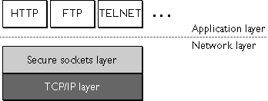
Secure Sockets Layer (cont.)
Lies above transport layer, below application layer
Can lie atop any transport protocol, not just TCP/IP
Runs under application protocols like HTTP, FTP, and TELNET

Slide 6
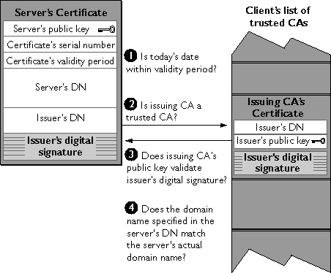
SSL: Server Authentication

Slide 7
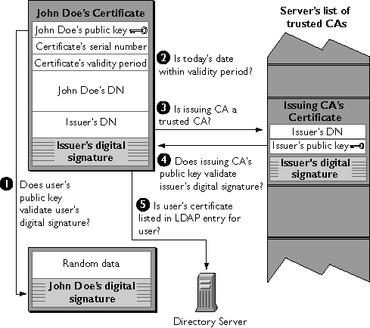
SSL: Client Authentication

Slide 8
References
J. Bradley. The SSLP Reference Implementation Project. Department of Computer Science, University of Bristol, UK.
C. Ellison and B. Schneier. “Ten Risks of PKI: What You’re not Being Told about Public Key Infrastructure,” Computer Security Journal, Vol. XVI, No. 1, 2000.
P. Gutmann. Encryption and Security Tutorial. Department of Computer Science, University of Auckland, NZ.
Netscape Communications Corporation website.
B. Schneier. “Chapter 1: Foundations,” Applied Cryptography, Second Edition.

